Slide 1
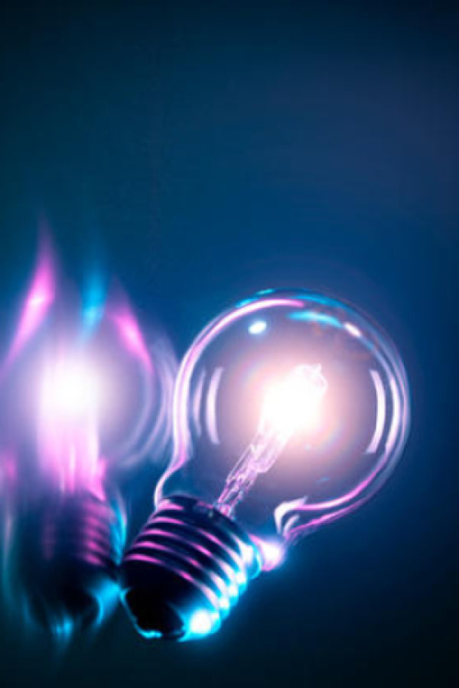
Electric current
How do we define current?
Macroscopic and microscopic description of current
Ohm’s law and resistance
Electrical power

Slide 2
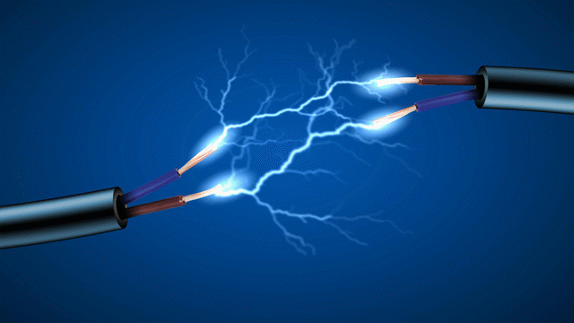
Electric current
A flow of charge is called an electric current

Slide 3


Electric current
A flow of charge is called an electric current
The current (symbol I) is the amount of charge Q [in Coulombs] flowing per unit time t [in seconds]
The units of current are C/s or “Amperes” A
$$I=\frac{Q}{t}$$
$$1 A=1 C/s$$

Slide 4
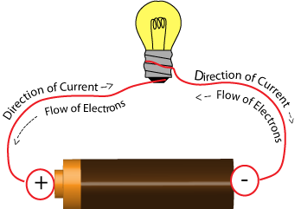
Electric current
Current is in the direction that positive charge flows
But in reality, current is transported by an opposite flow of negatively-charged electrons
Sometimes described as “conventional current” (positive) or “electron current” (negative)

Slide 5
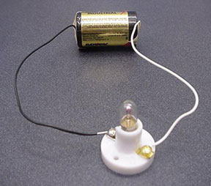
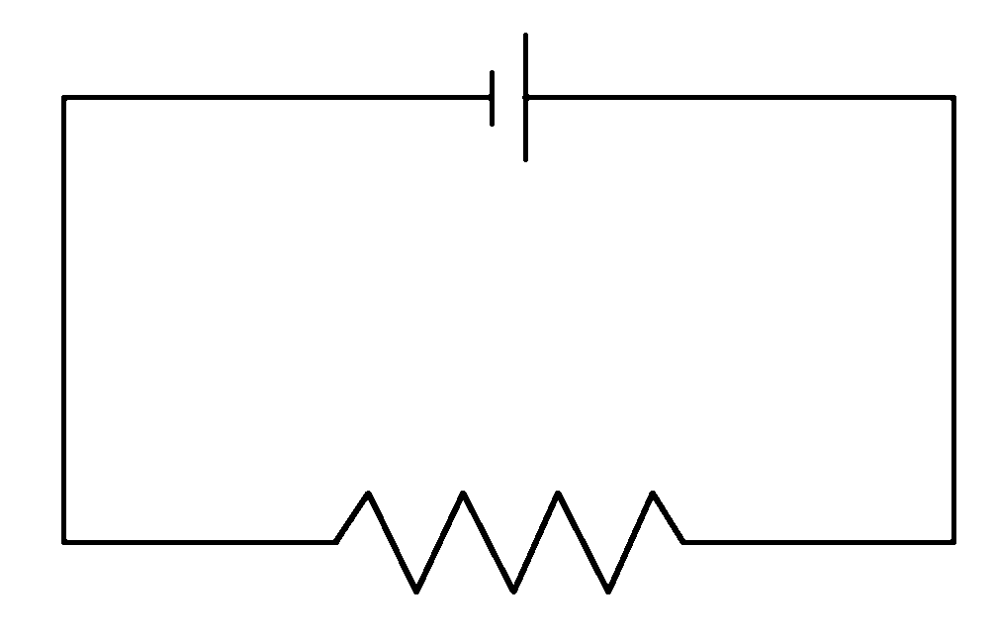
Electric current
How do we create an electric current?
Create an electric potential difference between two points
Connect those points to allow charge to flow
Dissipate the energy (e.g. into light, heat)
Circuit symbols!

Slide 6
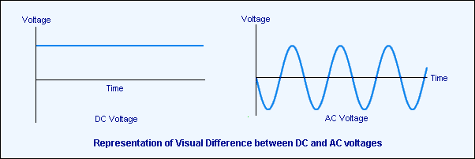
Electric current
Electrical power may be supplied as either a direct current or an alternating current
We will only cover direct current in this topic

Slide 7
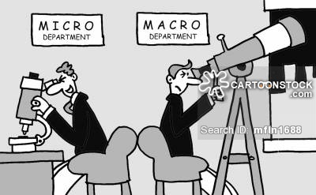
Macroscopic vs. Microscopic
In physics and chemistry we try and relate the overall macroscopic properties of a system to its microscopic nature

Slide 8
Microscopic nature of current
What really happens when a battery is connected?
particles are in constant thermal motion
+q
+q
+q
+q
+q
+q
+q
+q
+q
+q
+q

Slide 9
Microscopic nature of current
What really happens when a battery is connected?
The battery supplies a potential difference hence electric field
E
+q
+q
+q
+q
+q
+q
+q
+q
+q
+q
+q

Slide 10
Microscopic nature of current
What really happens when a battery is connected?
The charges feel a force from the electric field and start to accelerate
E
+q
+q
+q
+q
+q
+q
+q
+q
+q
+q
+q

Slide 11
Microscopic nature of current
What really happens when a battery is connected?
The charges undergo collisions with the other particles in the material which slows their motion
E
+q

Slide 12
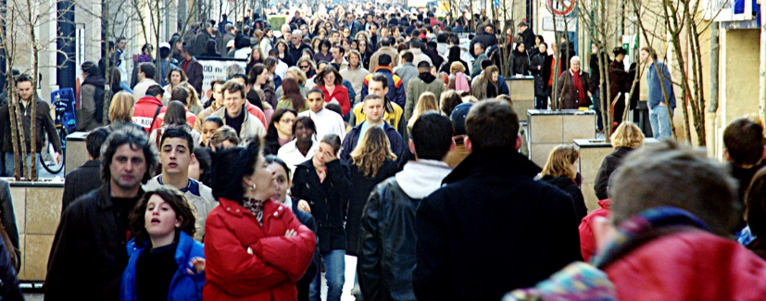
Microscopic nature of current
What really happens when a battery is connected?
These collisions produce a resistance to motion which results in an equilibrium drift velocity

Slide 13
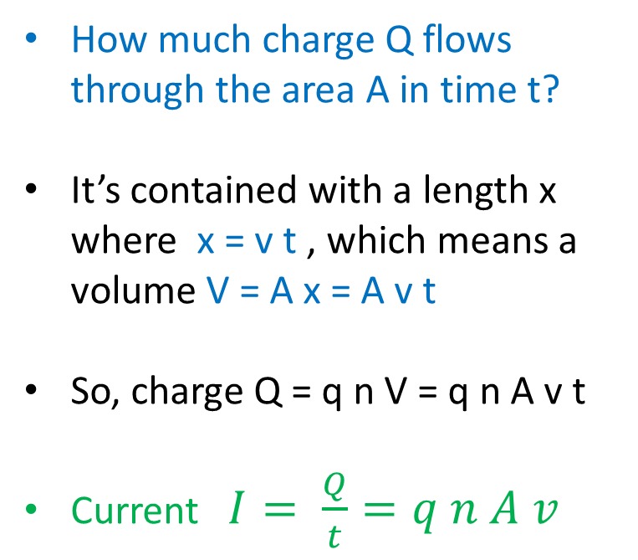
Microscopic nature of current
How much current is produced by drift velocity v?
x
How much charge Q flows through the area A in time t?
It’s contained with a length x where x = v t , which means a volume V = A x = A v t
So, charge Q = q n V = q n A v t
Current $I= \frac{Q}{t}=q n A v$
v
+q
v
A
+q
v
+q
Number density of charges = n

Slide 14
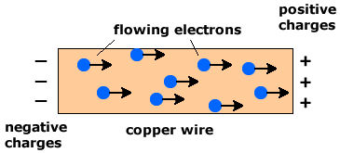





Microscopic nature of current
Exercise: A 5-A current flows in a copper wire with cross-sectional area 1 mm², carried by electrons with number density 1.1 x 10²⁹ m⁻³. What is the electron drift speed?
$$I=q n A v$$
$$I=5 A$$
$$q=1.6×{10}^{−19} C$$
$$n=1.1×{10}^{29} m^{−3}$$
$$A=1{ mm}^{2}={10}^{−6}{ m}^{2}$$
$$v=\frac{I}{q n A}=\frac{5}{(1.6×{10}^{−19})×(1.1×{10}^{29})×({10}^{−6})}=0.28 mm/s$$
Isn’t this incredibly slow? Yes – but the electric field itself is established at the speed of light.

Slide 15

Microscopic nature of current
The current density (symbol J) is the current flowing per unit area (“concentration of current”)
The units of J are A/m²
Used in a microscopic description of current
$$J=\frac{I}{A}=nqv$$

Slide 16
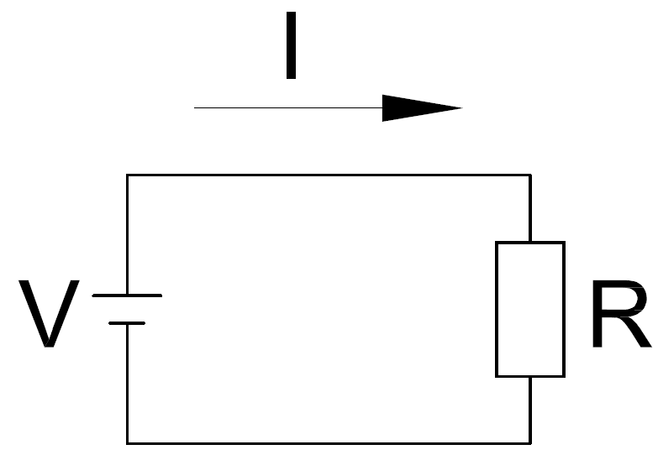
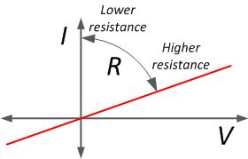



Ohm’s Law : macroscopic version
Ohm’s law describes the resistance of a material to the flow of current (or its inverse – conductance)
The greater the resistance, the less current can flow for a given potential difference
Resistance is measured in units of Ohms (symbol: $Ω$)
$$I=\frac{V}{R}$$
$$V=IR$$

Slide 17
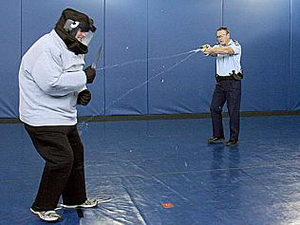
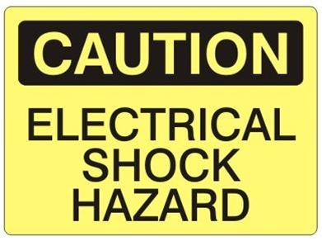

Ohm’s Law : electrical shock
Current of “only” 100 mA can be fatal to humans
Luckily, resistance between points on human skin $={10}^{5} Ω$
So, fatal voltage = V = I R = 0.1 x 10⁵ = 10,000 V
If skin is wet, resistance is reduced. Be careful!

Slide 18


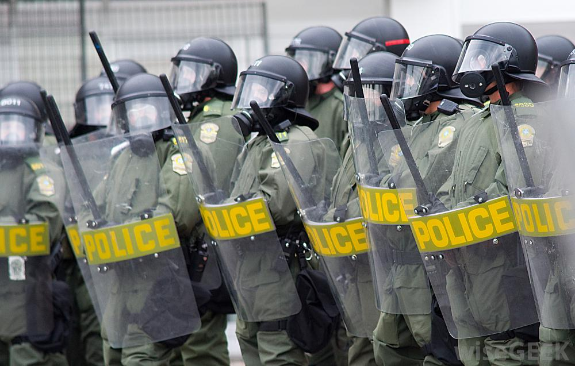
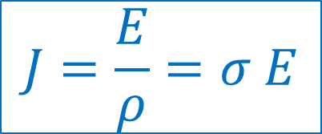
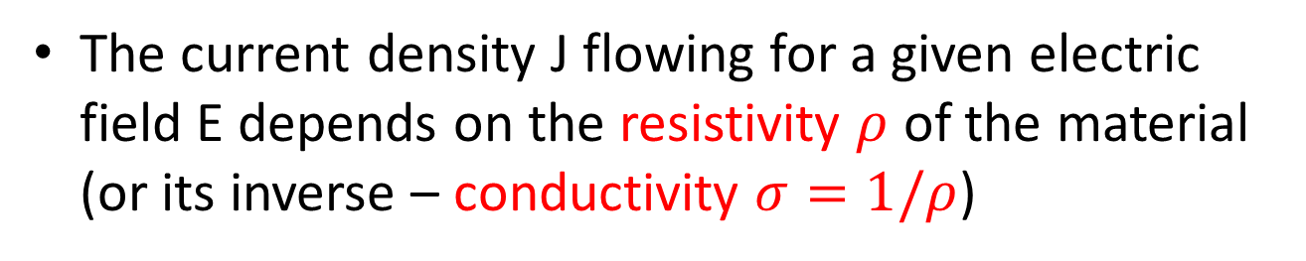

Ohm’s Law : microscopic version
The current density J flowing for a given electric field E depends on the resistivity $ρ$ of the material (or its inverse – conductivity $σ=1/ρ$)
$$J=\frac{E}{ρ}=σ E$$
High resistivity $ρ$ means low current!

Slide 19
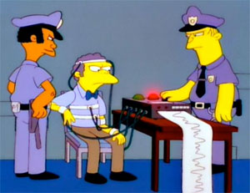
Ohm’s Law : “lie detection”
Sweat increases the conductance of the skin, which will change the current flowing for fixed voltage
“machines do detect deception better than chance, but with significant error rates”

Slide 20

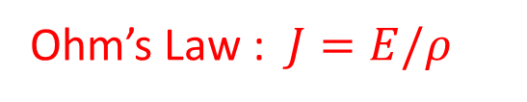
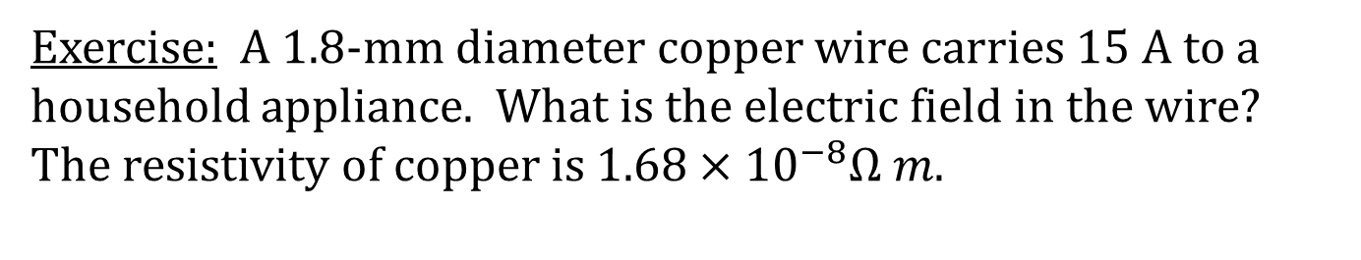
Ohm’s Law : microscopic version
Exercise: A 1.8-mm diameter copper wire carries 15 A to a household appliance. What is the electric field in the wire? The resistivity of copper is $1.68×{10}^{−8}Ω m.$
Ohm’s Law : $J=E/ρ$
Resistivity of copper : $ρ=1.68×{10}^{−8} Ω m$
Current density $J=\frac{I}{A}=\frac{I}{π r^{2}}=\frac{15}{π {(0.9×{10}^{−3})}^{2}}=5.9×{10}^{6} A m^{−2}$
Electric field : $E=J ρ=\left(5.9×{10}^{6}\right)×\left(1.68×{10}^{−8}\right)=0.099 V/m$

Slide 21



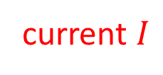
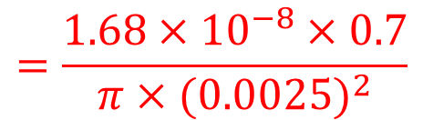
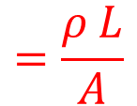



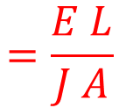


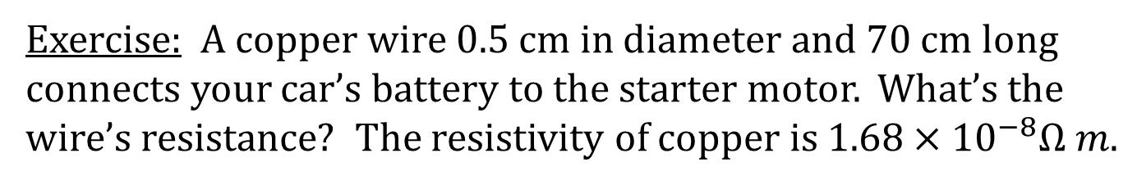
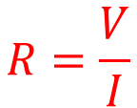

Ohm’s Law : microscopic version
Exercise: A copper wire 0.5 cm in diameter and 70 cm long connects your car’s battery to the starter motor. What’s the wire’s resistance? The resistivity of copper is $1.68×{10}^{−8}Ω m.$
current $I$
$$I=V/R$$
$$J=I/A$$
$$L$$
$$A$$
$$J=E/ρ$$
$$E=V/L$$
$$R=\frac{V}{I}$$
$$=\frac{E L}{J A}$$
$$=\frac{ρ L}{A}$$
$$=\frac{1.68×{10}^{−8}×0.7}{π×{(0.0025)}^{2}}$$
$$=6×{10}^{−4} Ω$$
Exercise: If the starter motor draws a current of 170 A, what’s the potential difference across the wire?
$$=0.1 V$$
$$=170×\left(6×{10}^{−4}\right)$$
$$V=I R$$

Slide 22
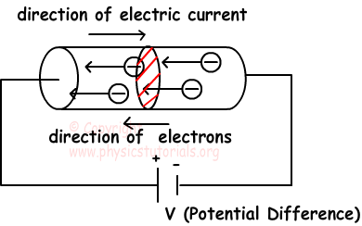
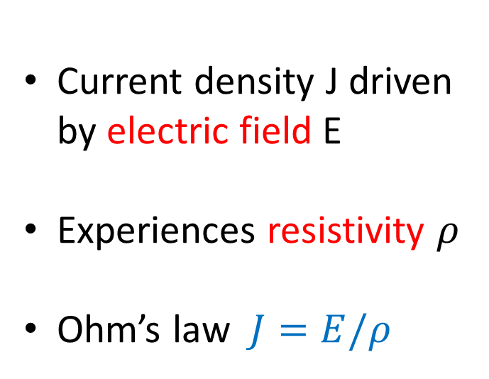
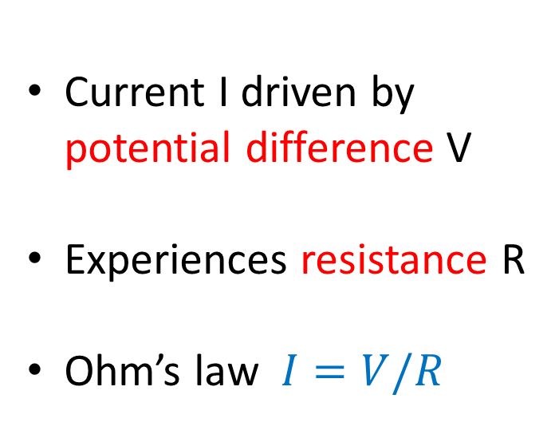
Macroscopic vs. Microscopic
Current I driven by potential difference V
Experiences resistance R
Ohm’s law $I=V/R$
Current density J driven by electric field E
Experiences resistivity $ρ$
Ohm’s law $J=E/ρ$

Slide 23
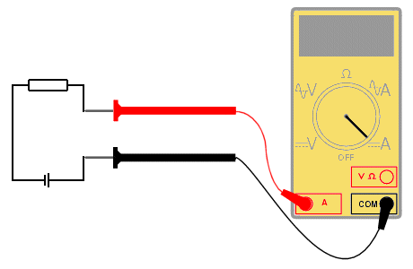
Electric current
Current can be measured using an ammeter

Slide 24
Two electrical measuring devices, X and Y, are placed in the circuit as shown to measure properties of the resistor. Which of the following descriptions is correct?
X
Y
X measures current, Y measures voltage
X measures voltage, Y measures current
X and Y measure current
X and Y measure voltage
Current is measured at a location – ammeters in series.
Voltage (potential difference) between two locations – voltmeters in parallel.

Slide 25
How does the current entering the resistor, I₁, compare to the current leaving the resistor, I₂?
I₂
I₁
I₁ < I₂
I₁ > I₂
I₁ = I₂
CHARGE CONSERVATION: charge cannot be created or destroyed.
Energy is dissipated as current flows through a resistance, but charge is conserved, so current in = current out.

Slide 26
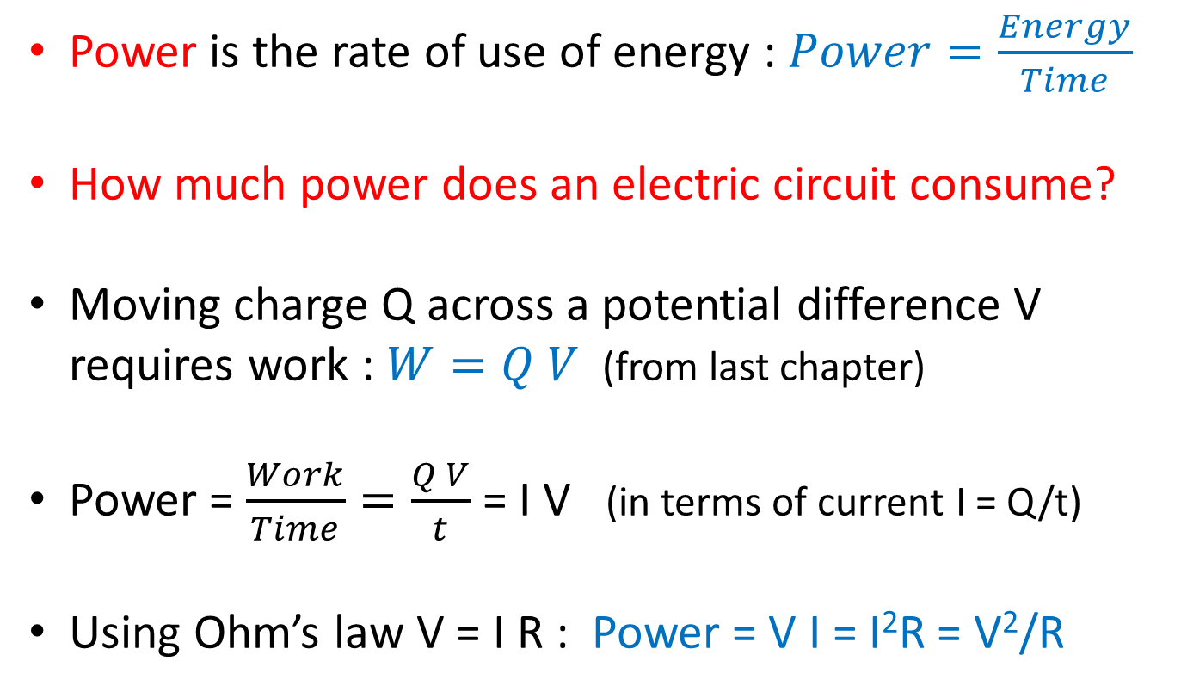
Electric power
Power is the rate of use of energy : $Power=\frac{Energy}{Time}$
How much power does an electric circuit consume?
Moving charge Q across a potential difference V requires work : $W=Q V$(from last chapter)
Power = $\frac{Work}{Time}=\frac{Q V}{t}$ = I V (in terms of current I = Q/t)
Using Ohm’s law V = I R : Power = V I = I²R = V²/R

Slide 27
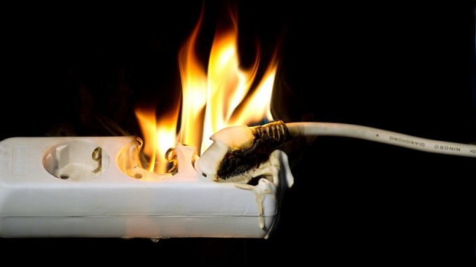
Electric power
This power is dissipated as heat energy in the resistance – why electrical components get hot!

Slide 28
Electric power
Power is measured in Watts (1 W = 1 J/s)
Your “power bill” is probably measured in “kWh” or “kilo-Watt hours”
This is really an “energy bill” …
1 kWh = 1000 J/s x 3600 s = 3.6 x 10⁶ J = 3.6 MJ

Slide 29
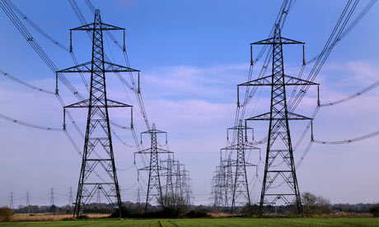
Electric power
Why do power lines operate at 100,000 V?
P = V I : high power can be delivered using high V or high I
Some power will be lost in heating the transmission wires
P = I²R : low current minimizes these transmission losses

Slide 30
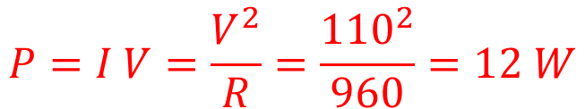
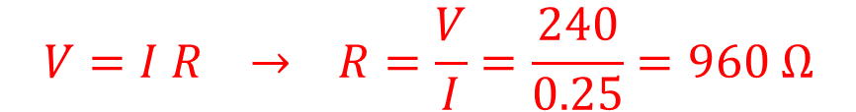
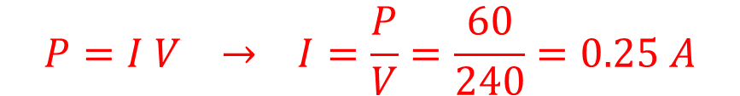
Electric power
Exercise: What is the resistance of a 60 W 240V light bulb?
Power P = 60 W
Voltage V = 240 V
$$P=I V → I=\frac{P}{V}=\frac{60}{240}=0.25 A$$
$$V=I R → R=\frac{V}{I}=\frac{240}{0.25}=960 Ω$$
Exercise: What would be the power output if the bulb was plugged into the US mains of 110 V?
$$P=I V=\frac{V^{2}}{R}=\frac{{110}^{2}}{960}=12 W$$

Slide 31
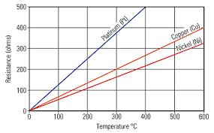
Thermal runaway and fuses
For most conductors, resistance is not completely constant, but increases with increasing temperature.
If part of a circuit starts to overheat, its resistance can increase, causing larger power dissipation, causing higher resistance etc.
A fuse protects a circuit from general damage by acting as the “weak point”; a thin wire that will physically fail (melt) if current exceeds a safe level.
“Circuit breakers” or “safety switches” either mechanical or electronic, are now able to offer faster and more reliable protection.

Slide 32
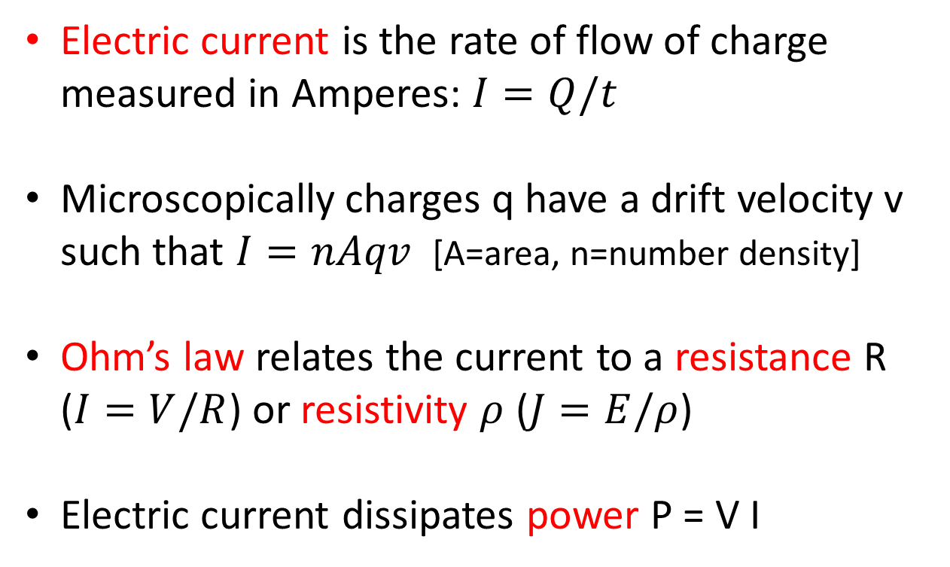
Summary
Electric current is the rate of flow of charge measured in Amperes: $I=Q/t$
Microscopically charges q have a drift velocity v such that $I=nAqv$ [A=area, n=number density]
Ohm’s law relates the current to a resistance R ($I=V/R$) or resistivity $ρ$ ($J=E/ρ$)
Electric current dissipates power P = V I

